Slide 1
Machine Learning Practice
9. Tuning Process

Slide 2
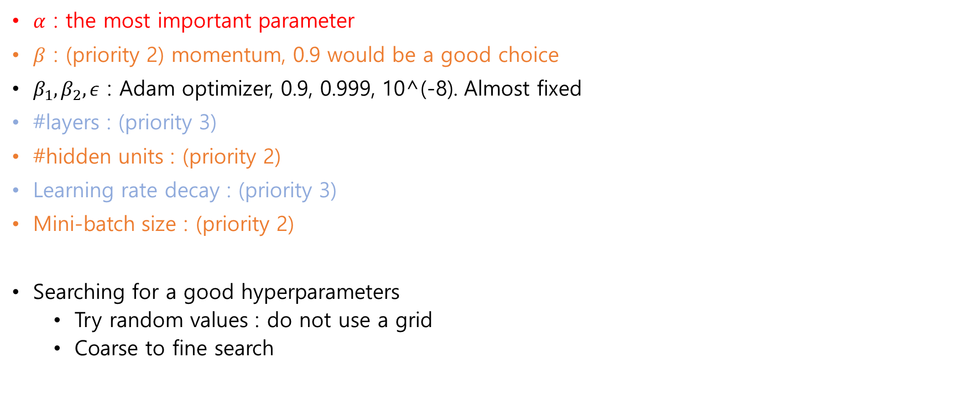
Hyperparameters
$α$ : the most important parameter
$β$ : (priority 2) momentum, 0.9 would be a good choice
$β_{1},β_{2},ε$ : Adam optimizer, 0.9, 0.999, 10^(-8). Almost fixed
#layers : (priority 3)
#hidden units : (priority 2)
Learning rate decay : (priority 3)
Mini-batch size : (priority 2)
Searching for a good hyperparameters
Try random values : do not use a grid
Coarse to fine search

Slide 3
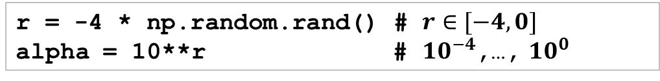

Using an appropriate scale to pick hyperparameters
Let’s say we try to choose $n^{\left[l\right]}=\left\{50, …, 100\right\}$
We also try to choose #layers = $\left\{2,3,4\right\}$
Then, the uniform distribution for the parameters would be sufficient
Assume that we try to choose $α$=[0.0001,1]
Instead of using a linear scale, we may choose to use a log scale.
r = -4 * np.random.rand() # $r∈[−4,0]$
alpha = 10**r # $10^{−4}$,…, $10^{0}$

Slide 4
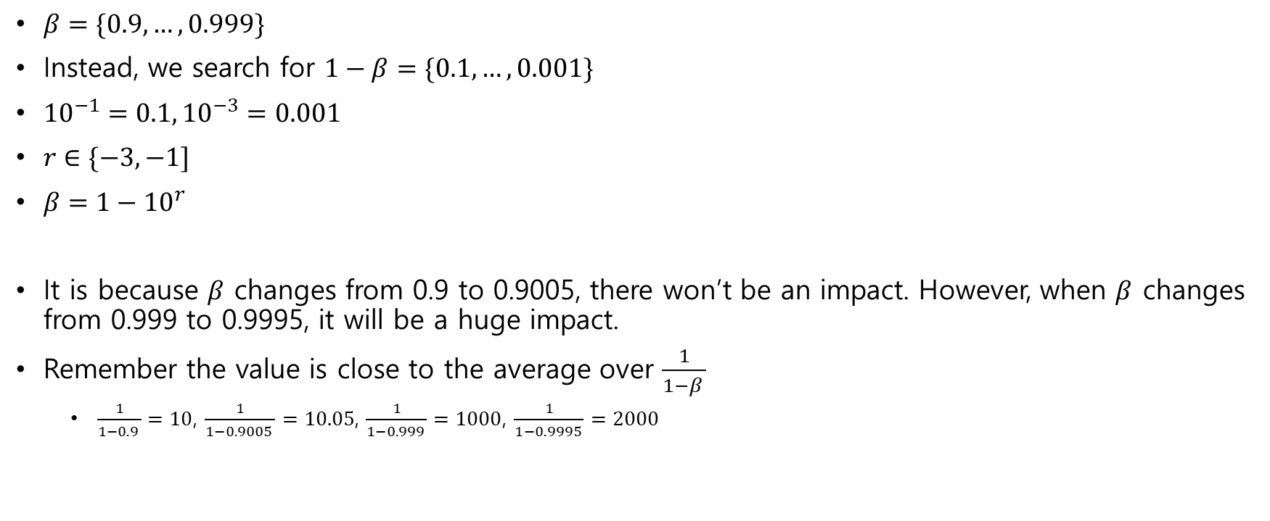
Hyperparameters for exponentially weighted averages
$β=\{0.9,…,0.999\}$
Instead, we search for $1−β=\{0.1,…,0.001\}$
${10}^{−1}=0.1, {10}^{−3}=0.001$
$r∈\{−3,−1]$
$β=1−{10}^{r}$
It is because $β$ changes from 0.9 to 0.9005, there won’t be an impact. However, when $β$ changes from 0.999 to 0.9995, it will be a huge impact.
Remember the value is close to the average over $\frac{1}{1−β }$
$\frac{1}{1−0.9 }=10$, $\frac{1}{1−0.9005 }=10.05$, $\frac{1}{1−0.999 }=1000$, $\frac{1}{1−0.9995 }=2000$

Slide 5
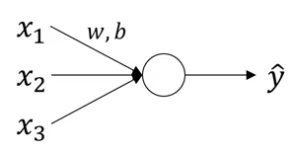
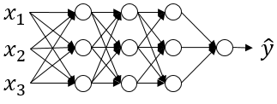

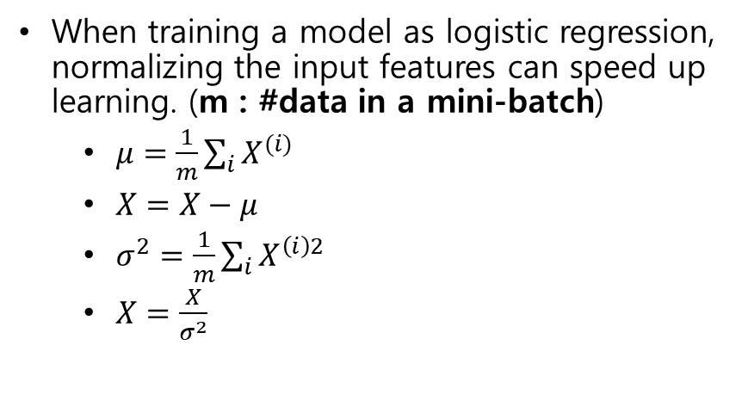

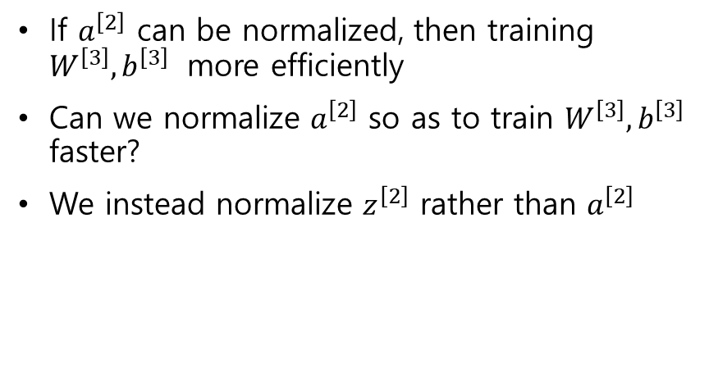
Batch normalization
$$W^{\left[3\right]},b^{\left[3\right]}$$
$$a^{\left[2\right]}$$
When training a model as logistic regression, normalizing the input features can speed up learning. (m : #data in a mini-batch)
$μ=\frac{1}{m}\sum_{i}{X^{(i)}}$
$X=X−μ$
$σ^{2}=\frac{1}{m}\sum_{i}{X^{\left(i\right)2}}$
$X=\frac{X}{σ^{2}}$
If $a^{\left[2\right]}$ can be normalized, then training $W^{\left[3\right]},b^{\left[3\right]}$ more efficiently
Can we normalize $a^{\left[2\right]}$ so as to train $W^{\left[3\right]},b^{\left[3\right]}$ faster?
We instead normalize $z^{\left[2\right]}$ rather than $a^{\left[2\right]}$

Slide 6
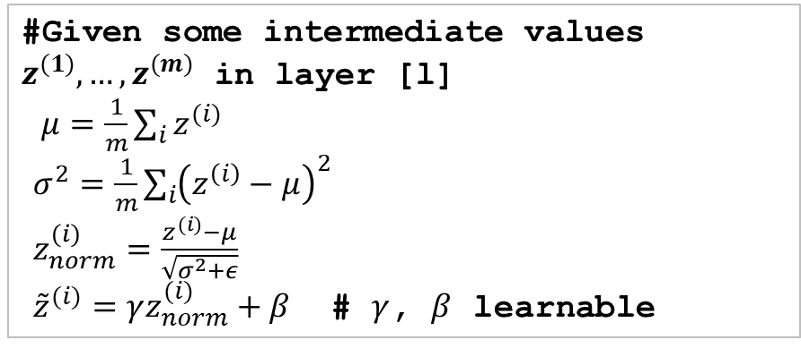
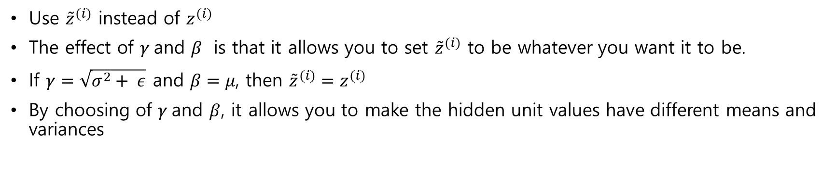
Batch normalization implementation
#Given some intermediate values $z^{(1)},…,z^{(m)}$ in layer [l]
$μ=\frac{1}{m}\sum_{i}{z^{(i)}}$
$σ^{2}=\frac{1}{m}\sum_{i}{{\left(z^{\left(i\right)}−μ\right)}^{2}}$
$z_{norm}^{(i)}=\frac{z^{(i)}−μ}{\sqrt{σ^{2}+ε}}$
${\tilde{z}}^{(i)}=γz_{norm}^{(i)}+β$ # $γ$, $β$ learnable
Use ${\tilde{z}}^{(i)}$ instead of $z^{(i)}$
The effect of $γ$and $β$ is that it allows you to set ${\tilde{z}}^{(i)}$ to be whatever you want it to be.
If $γ=\sqrt{σ^{2}+ ε}$ and $β=μ$, then ${\tilde{z}}^{(i)}=z^{(i)}$
By choosing of $γ$and $β$, it allows you to make the hidden unit values have different means and variances

Slide 7
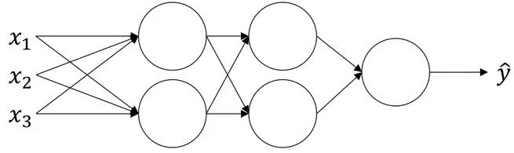







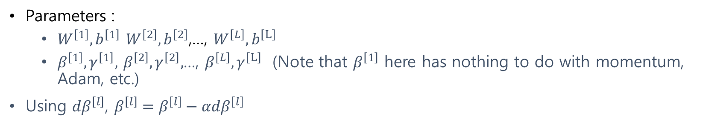














Adding Batch Norm to a NN
$$z_{1}^{\left[1\right]}$$
$$a_{1}^{\left[1\right]}$$
$$z_{1}^{\left[2\right]}$$
$$a_{1}^{\left[2\right]}$$
$$z_{2}^{\left[1\right]}$$
$$a_{2}^{\left[1\right]}$$
$$z_{2}^{\left[2\right]}$$
$$a_{2}^{\left[2\right]}$$
$$W^{\left[1\right]},b^{\left[1\right]}$$
$$β^{\left[1\right]},γ^{\left[1\right]}$$
$$W^{\left[2\right]},b^{\left[2\right]}$$
$$β^{\left[2\right]},γ^{\left[2\right]}$$
$$X$$
$$Z^{\left[1\right]}$$
$$\tilde{Z^{\left[1\right]}}$$
$$a^{\left[1\right]}=g^{\left[1\right]}\left({\tilde{z}}^{\left[1\right]}\right)$$
$$Z^{\left[2\right]}$$
$$\tilde{Z^{\left[2\right]}}$$
$$a^{\left[2\right]}=g^{\left[2\right]}\left({\tilde{z}}^{\left[2\right]}\right)$$
$$Batch Norm$$
$$Batch Norm$$
Parameters :
$W^{\left[1\right]},b^{\left[1\right]}$ $W^{\left[2\right]},b^{\left[2\right]}$,…, $W^{\left[L\right]},b^{\left[L\right]}$
$β^{\left[1\right]},γ^{\left[1\right]},$ $β^{\left[2\right]},γ^{\left[2\right]},$…, $β^{\left[L\right]},γ^{\left[L\right]}$(Note that $β^{\left[1\right]}$ here has nothing to do with momentum, Adam, etc.)
Using ${dβ}^{\left[l\right]}$, $β^{\left[l\right]}=β^{\left[l\right]}−α{dβ}^{\left[l\right]}$

Slide 8









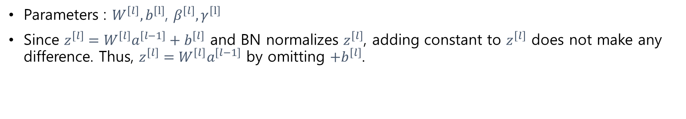














Working with mini-batches
$$W^{\left[1\right]},b^{\left[1\right]}$$
$$β^{\left[1\right]},γ^{\left[1\right]}$$
$$W^{\left[2\right]},b^{\left[2\right]}$$
$$β^{\left[2\right]},γ^{\left[2\right]}$$
$$X^{\left\{1\right\}}$$
$$Z^{\left[1\right]}$$
$$\tilde{Z^{\left[1\right]}}$$
$$a^{\left[1\right]}=g^{\left[1\right]}\left({\tilde{z}}^{\left[1\right]}\right)$$
$$Z^{\left[2\right]}$$
$$\tilde{Z^{\left[2\right]}}$$
$$a^{\left[2\right]}=g^{\left[2\right]}\left({\tilde{z}}^{\left[2\right]}\right)$$
$$BN$$
$$BN$$
$$W^{\left[1\right]},b^{\left[1\right]}$$
$$β^{\left[1\right]},γ^{\left[1\right]}$$
$$W^{\left[2\right]},b^{\left[2\right]}$$
$$β^{\left[2\right]},γ^{\left[2\right]}$$
$$X^{\left\{2\right\}}$$
$$Z^{\left[1\right]}$$
$$\tilde{Z^{\left[1\right]}}$$
$$a^{\left[1\right]}=g^{\left[1\right]}\left({\tilde{z}}^{\left[1\right]}\right)$$
$$Z^{\left[2\right]}$$
$$\tilde{Z^{\left[2\right]}}$$
$$a^{\left[2\right]}=g^{\left[2\right]}\left({\tilde{z}}^{\left[2\right]}\right)$$
$$BN$$
$$BN$$
…
Parameters : $W^{\left[l\right]},b^{\left[l\right]}$, $β^{\left[l\right]},γ^{\left[l\right]}$
Since $z^{\left[l\right]}=W^{\left[l\right]}a^{\left[l−1\right]}+b^{\left[l\right]}$ and BN normalizes $z^{\left[l\right]}$, adding constant to $z^{\left[l\right]}$ does not make any difference. Thus, $z^{\left[l\right]}=W^{\left[l\right]}a^{\left[l−1\right]}$ by omitting $+b^{\left[l\right]}$.

Slide 9
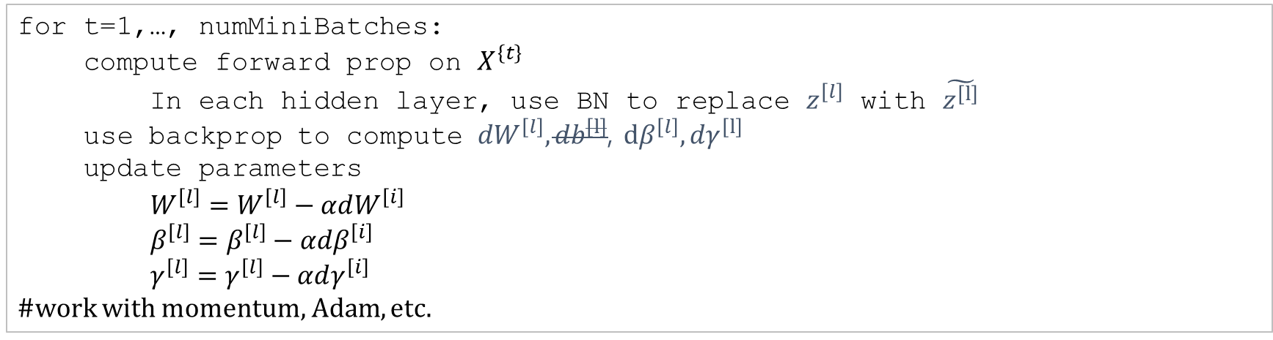
Implementing gradient descent
for t=1,…, numMiniBatches:
compute forward prop on $X^{\left\{t\right\}}$
In each hidden layer, use BN to replace $z^{\left[l\right]}$ with $\tilde{z^{\left[l\right]}}$
use backprop to compute ${dW}^{\left[l\right]},{db}^{\left[l\right]}$, $dβ^{\left[l\right]},{dγ}^{\left[l\right]}$
update parameters
$W^{\left[l\right]}=W^{\left[l\right]}−αdW^{\left[i\right]}$
$β^{\left[l\right]}=β^{\left[l\right]}−αdβ^{\left[i\right]}$
$γ^{\left[l\right]}=γ^{\left[l\right]}−αdγ^{\left[i\right]}$
#work with momentum, Adam, etc.

Slide 10
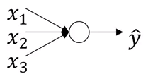
Why does BN work?
First, like normalizing input X for speed-up, BN works similarly for hidden layers.
Second, it makes weights more robust to changes to weights in earlier layers of the NN.
For example, when the left data is given, we cannot expect our model to find an appropriate boundary for the right data. (covariant shift)
If you've learned some X to Y mapping, if the distribution of X changes, then you might need to retrain your learning algorithm. And this is true even if the ground true function mapping from X to Y remains unchanged

Slide 11
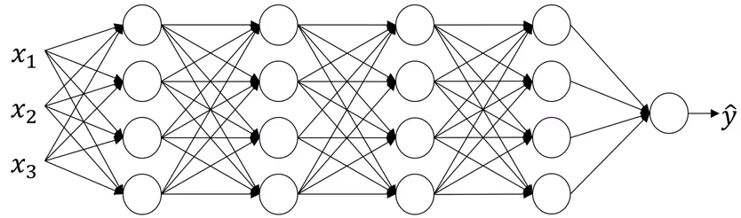
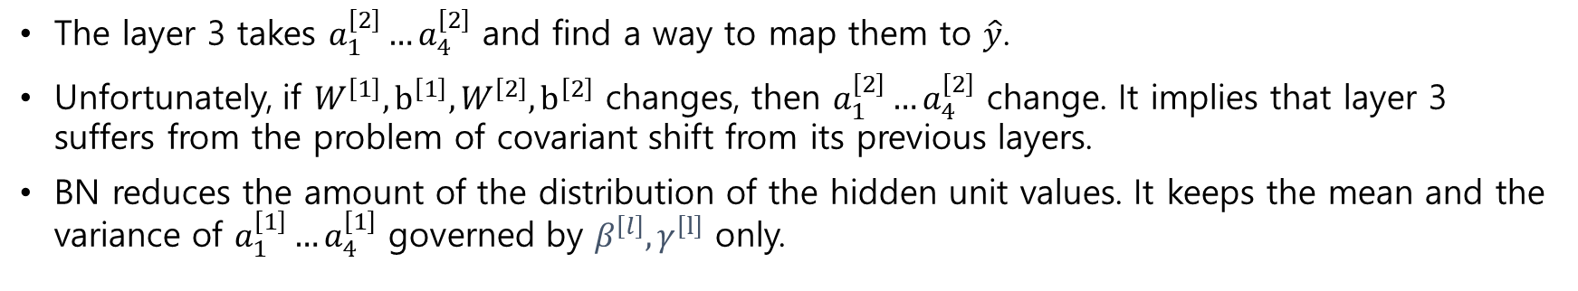



Why does BN work?
$$a_{1}^{\left[2\right]}$$
$$a_{2}^{\left[2\right]}$$
$$W^{\left[3\right]},b^{\left[3\right]}$$
The layer 3 takes $a_{1}^{\left[2\right]}…a_{4}^{\left[2\right]}$ and find a way to map them to $\hat{y}$.
Unfortunately, if $W^{\left[1\right]},b^{\left[1\right]},W^{\left[2\right]},b^{\left[2\right]}$ changes, then $a_{1}^{\left[2\right]}…a_{4}^{\left[2\right]}$ change. It implies that layer 3 suffers from the problem of covariant shift from its previous layers.
BN reduces the amount of the distribution of the hidden unit values. It keeps the mean and the variance of $a_{1}^{\left[1\right]}…a_{4}^{\left[1\right]}$ governed by $β^{\left[l\right]},γ^{\left[l\right]}$ only.

Slide 12

Batch Norm as regularization (2nd effect)
Each mini-batch is scaled by the mean/variance computed on just that mini-batch.
This adds some noise to the values $z^{[l]}$ within that minibatch. So similar to dropout, it adds some noise to each hidden layer’s activations.
This has a slight regularization effect.
As using a bigger mini-batch size, the effect of regularization is reduced.
[Reference]
S. Santurkar, et al, “How Does Batch Normalization Help Optimization? (No, It Is Not About Internal Covariate Shift)”, https://arxiv.org/abs/1805.11604

Slide 13
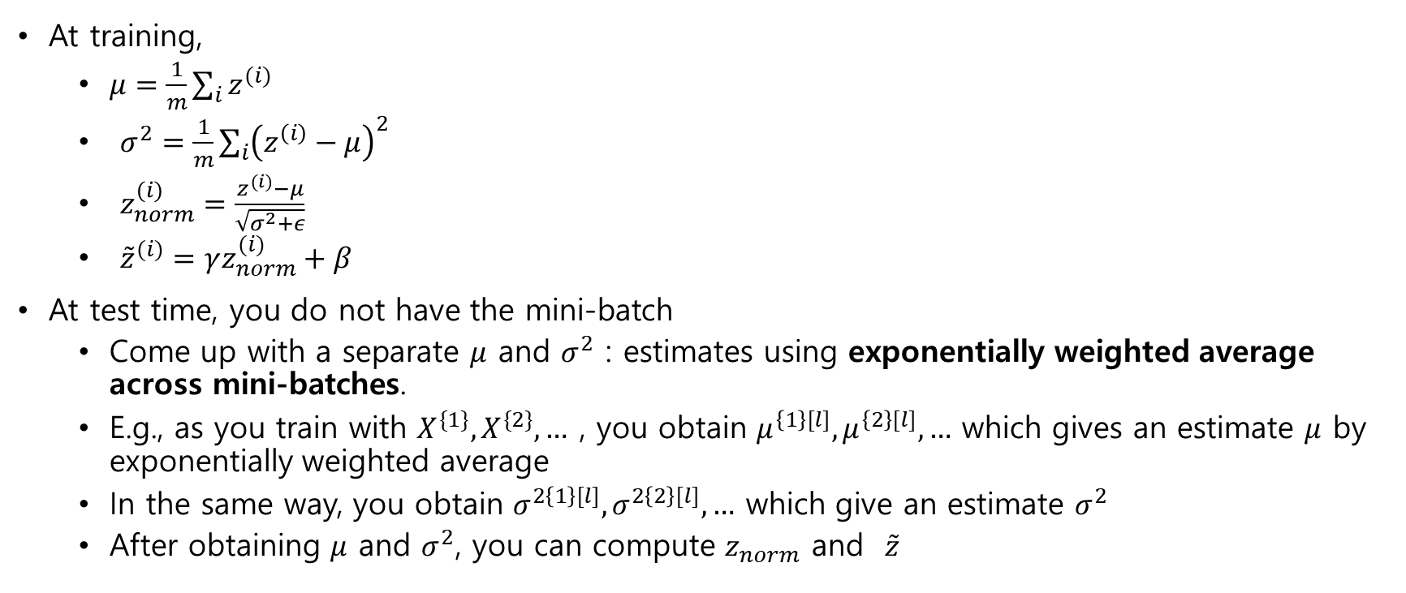
Batch Norm at test time
At training,
$μ=\frac{1}{m}\sum_{i}{z^{(i)}}$
$σ^{2}=\frac{1}{m}\sum_{i}{{\left(z^{\left(i\right)}−μ\right)}^{2}}$
$z_{norm}^{(i)}=\frac{z^{(i)}−μ}{\sqrt{σ^{2}+ε}}$
${\tilde{z}}^{(i)}=γz_{norm}^{(i)}+β$
At test time, you do not have the mini-batch
Come up with a separate $μ$ and $σ^{2}$ : estimates using exponentially weighted average across mini-batches.
E.g., as you train with $X^{\{1\}},X^{\{2\}},…$ , you obtain $μ^{\left\{1\right\}[l]},μ^{\left\{2\right\}[l]},…$ which gives an estimate $μ$ by exponentially weighted average
In the same way, you obtain $σ^{2\left\{1\right\}[l]},σ^{2\left\{2\right\}[l]},…$ which give an estimate $σ^{2}$
After obtaining $μ$ and $σ^{2}$, you can compute $z_{norm}$ and $\tilde{z}$

Slide 14
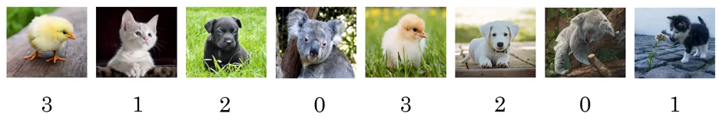
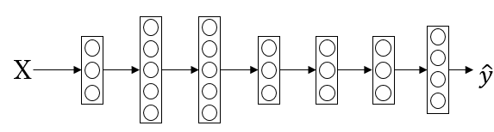





Multi-class classification using softmax regression
C : #classes=4 (0, …, 3)
$$P(other|X)$$
$$P(cat|X)$$
$$P(dog|X)$$
$$P(babychick|X)$$
$$n^{\left\{L\right]}=4$$

Slide 15
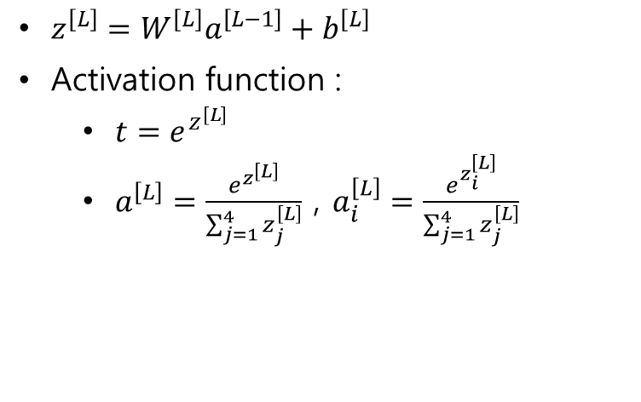
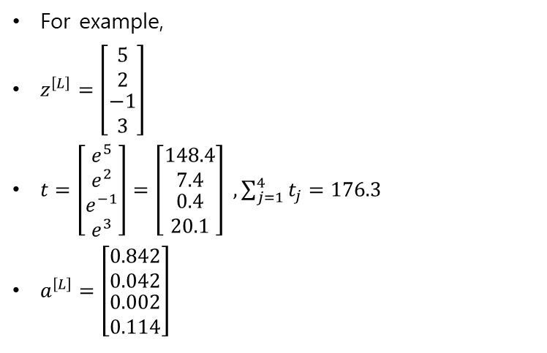
Softmax layer
For example,
$z^{\left[L\right]}=\left[\begin{matrix}5 \\ 2 \\ \begin{aligned}−1 \\ 3\end{aligned}\end{matrix}\right]$
$t=\left[\begin{matrix}e^{5} \\ e^{2} \\ \begin{aligned}e^{−1} \\ e^{3}\end{aligned}\end{matrix}\right]=\left[\begin{matrix}148.4 \\ 7.4 \\ \begin{aligned}0.4 \\ 20.1\end{aligned}\end{matrix}\right] , \sum_{j=1}^{4}{t_{j}}=176.3$
$a^{\left[L\right]}=\left[\begin{matrix}0.842 \\ 0.042 \\ \begin{aligned}0.002 \\ 0.114\end{aligned}\end{matrix}\right]$
$z^{\left[L\right]}=W^{\left[L\right]}a^{\left[L−1\right]}+b^{\left[L\right]}$
Activation function :
$t=e^{z^{\left[L\right]}}$
$a^{\left[L\right]}=\frac{e^{z^{\left[L\right]}}}{\sum_{j=1}^{4}{z_{j}^{\left[L\right]}}}$ , $a_{i}^{\left[L\right]}=\frac{e^{z_{i}^{\left[L\right]}}}{\sum_{j=1}^{4}{z_{j}^{\left[L\right]}}}$

Slide 16
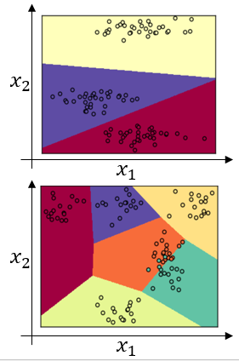
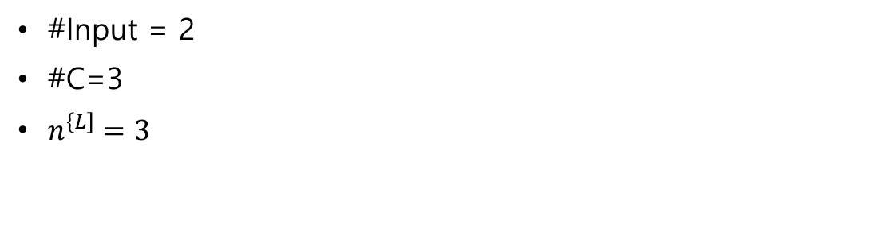
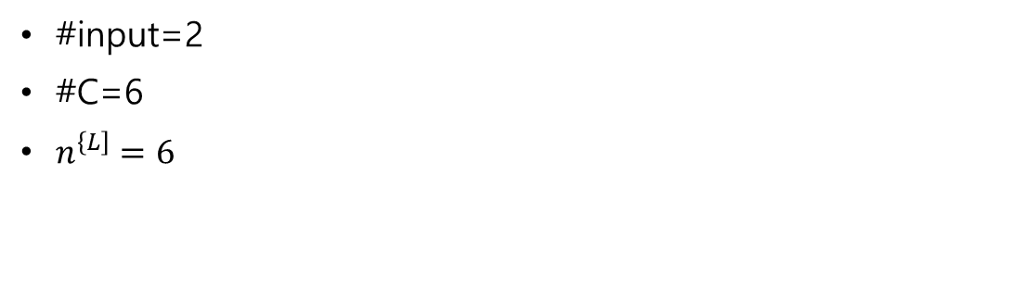
Softmax example
#Input = 2
#C=3
$n^{\left\{L\right]}=3$
#input=2
#C=6
$n^{\left\{L\right]}=6$

Slide 17
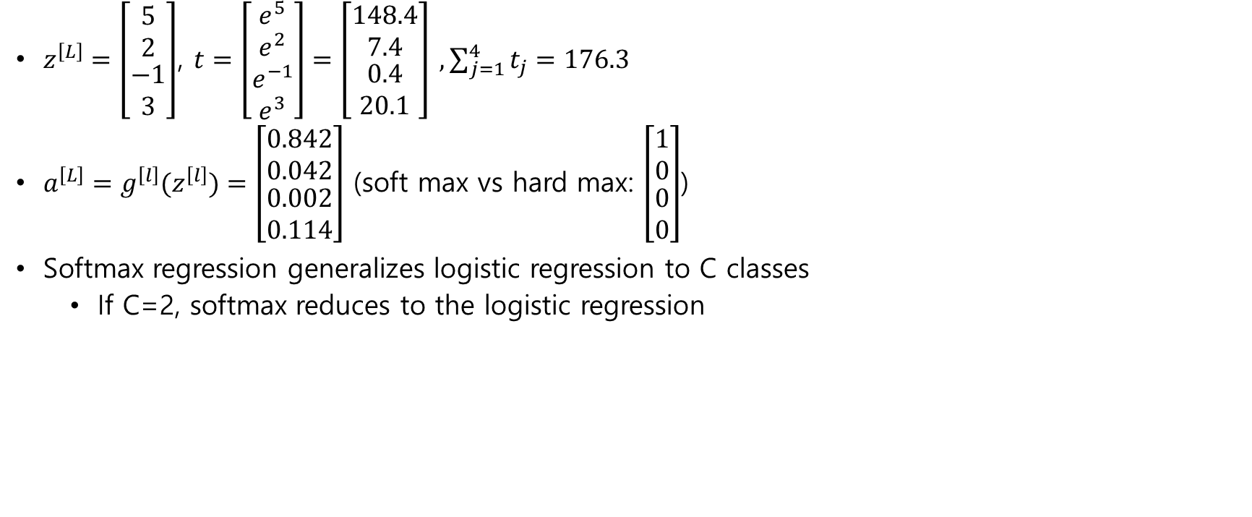
Training a softmax classifier
$z^{\left[L\right]}=\left[\begin{matrix}5 \\ 2 \\ \begin{aligned}−1 \\ 3\end{aligned}\end{matrix}\right]$, $t=\left[\begin{matrix}e^{5} \\ e^{2} \\ \begin{aligned}e^{−1} \\ e^{3}\end{aligned}\end{matrix}\right]=\left[\begin{matrix}148.4 \\ 7.4 \\ \begin{aligned}0.4 \\ 20.1\end{aligned}\end{matrix}\right] , \sum_{j=1}^{4}{t_{j}}=176.3$
$a^{\left[L\right]}=g^{\left[l\right]}(z^{\left[l\right]})=\left[\begin{matrix}0.842 \\ 0.042 \\ \begin{aligned}0.002 \\ 0.114\end{aligned}\end{matrix}\right]$ (soft max vs hard max: $\left[\begin{matrix}1 \\ 0 \\ \begin{aligned}0 \\ 0\end{aligned}\end{matrix}\right]$)
Softmax regression generalizes logistic regression to C classes
If C=2, softmax reduces to the logistic regression

Slide 18
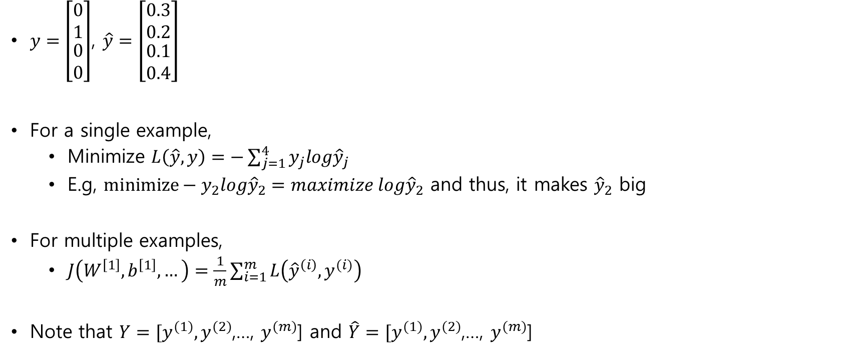
Loss function
$y=\left[\begin{matrix}0 \\ 1 \\ \begin{aligned}0 \\ 0\end{aligned}\end{matrix}\right]$, $\hat{y}=\left[\begin{matrix}0.3 \\ 0.2 \\ \begin{aligned}0.1 \\ 0.4\end{aligned}\end{matrix}\right]$
For a single example,
Minimize $L\left(\hat{y},y\right)=−\sum_{j=1}^{4}{y_{j}log{\hat{y}}_{j}}$
E.g, $minimize−y_{2}log{\hat{y}}_{2}=maximize log{\hat{y}}_{2}$ and thus, it makes ${\hat{y}}_{2}$ big
For multiple examples,
$J\left(W^{\left[1\right]},b^{\left[1\right]},…\right)=\frac{1}{m}\sum_{i=1}^{m}{L\left({\hat{y}}^{\left(i\right)},y^{(i)}\right)}$
Note that $Y=[y^{(1)},y^{(2)}$,…, $y^{(m)}$] and $\hat{Y}=[y^{(1)},y^{(2)}$,…, $y^{(m)}$]

Slide 19
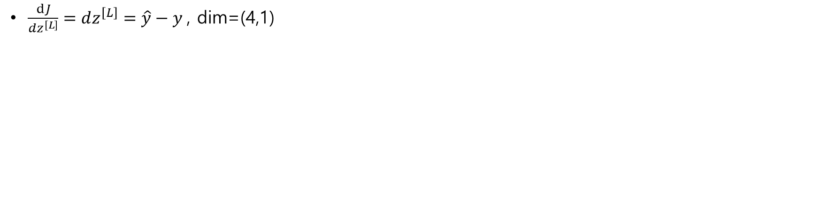
Gradient descent with softmax
$\frac{dJ}{dz^{\left[L\right]}}=dz^{\left[L\right]}=\hat{y}−y$, dim=(4,1)

